Slide 1

Data Link Layer
Lecture 16 | Part 1 of 5 | CSE421 –Computer Networks
Department of Computer Science and Engineering School of Data & Science

Slide 2
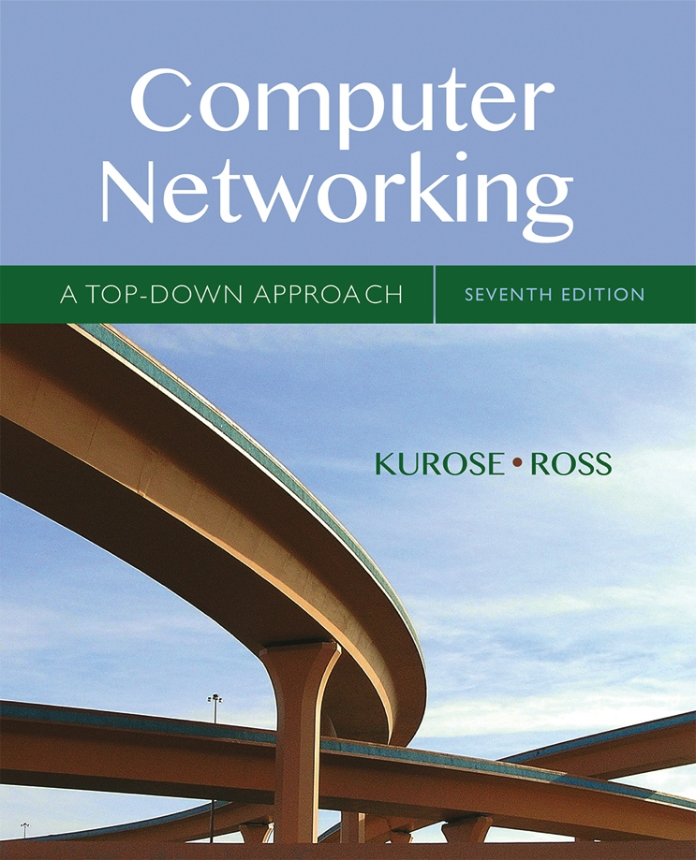

Based on Chapter 6 The Link Layer and LANs
Computer Networking: A Top Down Approach
7th edition Jim Kurose, Keith Ross Pearson/Addison Wesley April 2016
The slides are adapted from Kurose and Ross, Computer Networks 7th edition, Kurose and Ross.
All material copyright 1996-2016
J.F Kurose and K.W. Ross, All Rights Reserved

Slide 3
Chapter 6: Link layer and LANs
Our objectives:
understand principles behind link layer services:
error detection, correction (done in CSE320)
sharing a broadcast channel: multiple access
Framing - link layer addressing
local area networks: Ethernet

Slide 4
Part - 1
Application
Presentation
Session
Transport
Introduction to Link Layer
Network
Data link
Physical

Slide 5
Link Layer Terminology
Nodes : hosts and routers
Links:
wired links
wireless links
Frame : layer-2 packet
data-link layer has responsibility of
transferring datagram from one node
to physically adjacent node over a link

Slide 6
Link layer: context
datagram transferred by different link protocols over different links:
e.g., Ethernet on first link, frame relay on intermediate links, 802.11 on last link
each link protocol provides different services
Transportation analogy:
trip from Home to Cox’s Bazaar
Uber Car : Home to Dhaka Airport
Plane: Dhaka to Chittagong
Bus: Chittagong to Cox’s Bazaar
tourist = datagram
transport segment = communication link
transportation mode = link layer protocol
travel agent = routing algorithm
WAN Protocol : Frame Relay
Ethernet
Ethernet
802.11

Slide 7
Link layer services
Framing
encapsulate datagram into frame, adding header, trailer
“MAC” addresses used in frame headers to identify source, destination
different from IP address!
Link access:
channel access if shared medium
Reliable delivery between adjacent nodes
we learned how to do this already (Transport Layer)
seldom used on low bit-error link (fiber, some twisted pair)
wireless links: high error rates
Q: why both link-level and end-end reliability?

Slide 8
Link layer services (more)
error detection:
errors caused by signal attenuation, noise.
receiver detects presence of errors:
signals sender for retransmission or drops frame
error correction:
receiver identifies and corrects bit error(s) without resorting to retransmission
flow control:
pacing between adjacent sending and receiving nodes
half-duplex and full-duplex
with half duplex, nodes at both ends of link can transmit, but not at same time

Slide 9
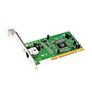
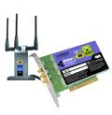

Where is the link layer implemented?
in each and every host
link layer implemented in “adaptor” (aka network interface card NIC) or on a chip
Ethernet card, 802.11 card; Ethernet chipset
implements link, physical layer
attaches into host’s system buses
combination of hardware, software, firmware
application
transport
network
link
cpu
memory
link
physical
host
bus
(e.g., PCI)
controller
physical
transmission
network adapter
card

Slide 10
Adaptors communicating
datagram
datagram
controller
controller
sending host
receiving host
datagram
frame
sending side:
encapsulates datagram in frame
adds error checking bits, rdt, flow control, etc.
receiving side
looks for errors, rdt, flow control, etc.
extracts datagram, passes to upper layer at receiving side

Slide 11
Objectives of Part 2
Our Objectives:
Types of Links
Multi Access Protocols
Types of Multi Access Protocols
Channel Partitioning Protocols
Random Access protocols
Taking Turns Protocols

Slide 12
Links
Links
Point-to-point
Broadcast
point-to-point
Example :Router to router connection
Example protocols : PPP, HDLC

Slide 13
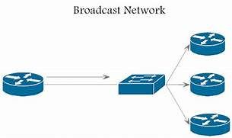

Multiple access links, protocols
broadcast (shared wire or medium)
old-fashioned Ethernet
upstream satellite network
802.11 wireless LAN
wireless LAN
shared wire (e.g.,
cabled Ethernet)
humans at a
party
(shared air, acoustical)
shared RF
(satellite)

Slide 14
Multiple access link problems
Problem
Single shared broadcast channel
Collision
BOOM!

Slide 15
Multiple access protocols
Solution:
Multiple access protocol
distributed algorithm that determines how nodes share channel, i.e., determine when node can transmit

Slide 16
An ideal multiple access protocol
given: broadcast channel of rate R bps
desiderata:
1. Efficient :when one node wants to transmit, it can send at rate R.
2. Fair : when M nodes want to transmit, each can send at average rate R/M
3. Fully decentralized:
no special node to coordinate transmissions
no synchronization of clocks, slots
4. Simple

Slide 17
MAC protocols: types
MAC Protocols
Channel Partitioning
Random Access
Taking Turns
divide channel into smaller “pieces” (time slots, frequency, code)
allocate piece to node for exclusive use
channel not divided, allow collisions
“recover” from collisions
nodes take turns, but nodes with more to send can take longer turns

Slide 18
Channel Partitioning MAC Protocols
Time Division Multiple Access
Frequency Division Multiple Access
Code Division Multiple Access

Slide 19
TDMA: Time Division Multiple Access
TDMA divides divides the time frames into time slots.
Each slot is assigned to one of the nodes.
Slots sizes are usually the same as the packet (frame) size of node.
Advantages
Eliminates collision
Each node gets dedicated R/N bps during frame time.
Frequency

Slide 20
Channel partitioning MAC protocols: TDMA
Disadvantages:
Unused slots go idle
Example: 6-station LAN, 1,3,4 have packets to send, slots 2,5,6 idle
When there is only one node to transmit
Then the node is limited to an average rate of R/N bps
The node must wait for it’s turn to transmit
6-slot
frame
6-slot
frame
1
3
4
1
3
4

Slide 21
FDMA: Frequency Division Multiple Access
channel spectrum divided into frequency bands
each station assigned fixed frequency band
Disadvantage
unused transmission time in frequency bands go idle
example: only band 1 have packet to send, frequency bands 2 & 3 remains idle
Limited bandwidth of R/N for each node
Frequency
f3
f2
f1
Time

Slide 22
CDMA: Code Division Multiple Access
Assigns a different code to each node.
Each node then uses its unique code to encode the data bits it sends.
Disadvantage
Total frequency band is used inefficiently.

Slide 23
Objectives of Part 3
Our objectives:
understand Random Access Protocols:
slotted ALOHA
ALOHA
CSMA, CSMA/CD

Slide 24
Random access protocols
when node has packet to send
transmit at full channel data rate R.
no previous coordination among nodes
two or more transmitting nodes ➜ “collision”,
random access MAC protocol specifies:
how to detect collisions
how to recover from collisions (e.g., via delayed retransmissions)

Slide 25
Random access protocols
Types of random access MAC protocols:
slotted ALOHA
ALOHA
CSMA, CSMA/CD, CSMA/CA

Slide 26
Slotted ALOHA
Operation:
Transmits in next slot
if no collision: node can send new frame in next slot
if collision: node retransmits frame in each subsequent slot with prob. p until success
Assumptions:
All frames same size
Time divided into equal size slots
Nodes start to transmit only slot beginning
If 2 or more nodes transmit in slot, all nodes detect collision

Slide 27
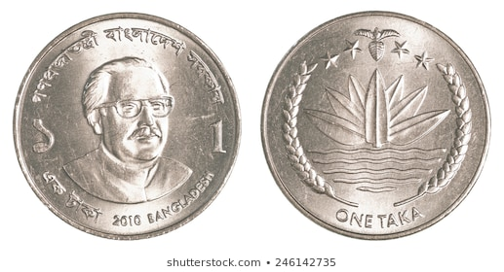
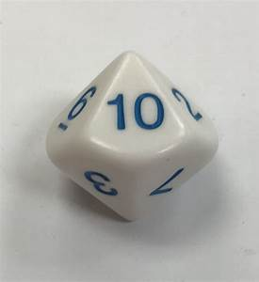
Example
P=10%
P=50%
Frame can be sent
Frame cannot be sent
10 sided dice

Slide 28
Slotted ALOHA
node 1
1
1
1
1
node 2
2
2
2
node 3
3
3
3
C
E
C
S
E
C
E
S
S
Pros:
single active node can continuously transmit at full rate of channel
highly decentralized: only slots in nodes need to be in sync
simple
Cons:
collisions, wasting slots
idle slots
nodes may be able to detect collision in less than time to transmit packet
clock synchronization

Slide 29
Slotted ALOHA: efficiency
Efficiency:
Fraction of successful slots
Suppose:
N nodes with many frames to send, each transmits in slot with probability p
prob that given node has success in a slot = p(1-p)^{N-1}
prob that any node has a success = Np(1-p)^{N-1}
Maximum Efficiency
Find p* that maximizes Np(1-p)^{N-1}
Find the limit of Np*(1-p*)^{N-1} as N goes to infinity, gives:
Max efficiency = 1/e = 0.37

Slide 30
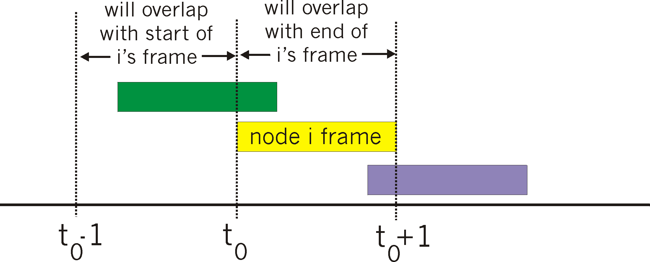
Pure (unslotted) ALOHA
unslotted Aloha: simpler, no synchronization
when frame first arrives
transmit immediately
collision probability increases:
frame sent at t₀ collides with other frames sent in [t₀-1,t₀+1]

Slide 31
Pure ALOHA efficiency
P(success by given node) = P(node transmits) .
P(no other node transmits in [t₀-1,t₀] .
P(no other node transmits in [t₀-1,t₀]
= p . (1-p)^{N-1 .} (1-p)^{N-1}
= p . (1-p)^{2(N-1)}
… choosing optimum p and then letting n
= 1/(2e) = .18
even worse than slotted Aloha!

Slide 32
Objectives of Part 4
Our objectives:
understand Random Access Protocols:
slotted ALOHA
ALOHA
CSMA, CSMA/CD

Slide 33
CSMA (carrier sense multiple access)
CSMA: listen before transmit:
if channel sensed idle
transmit entire frame
if channel sensed busy
defer transmission
human analogy: don’t interrupt others!

Slide 34

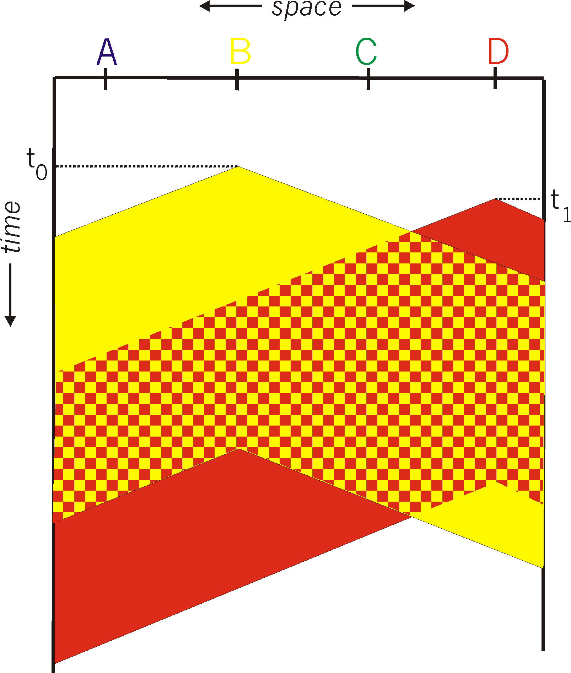
CSMA collisions
spatial layout of nodes
Collisions can still occur: propagation delay means two nodes may not hear each other’s transmission
Collision: entire packet transmission time wasted
distance & propagation delay play role in in determining collision probability

Slide 35
CSMA/CD (collision detection)
CSMA/CD: carrier sensing, deferral as in CSMA
collisions detected within short time
colliding transmissions aborted, reducing channel wastage
collision detection:
easy in wired LANs: measure signal strengths, compare transmitted, received signals
difficult in wireless LANs: received signal strength overwhelmed by local transmission strength

Slide 36
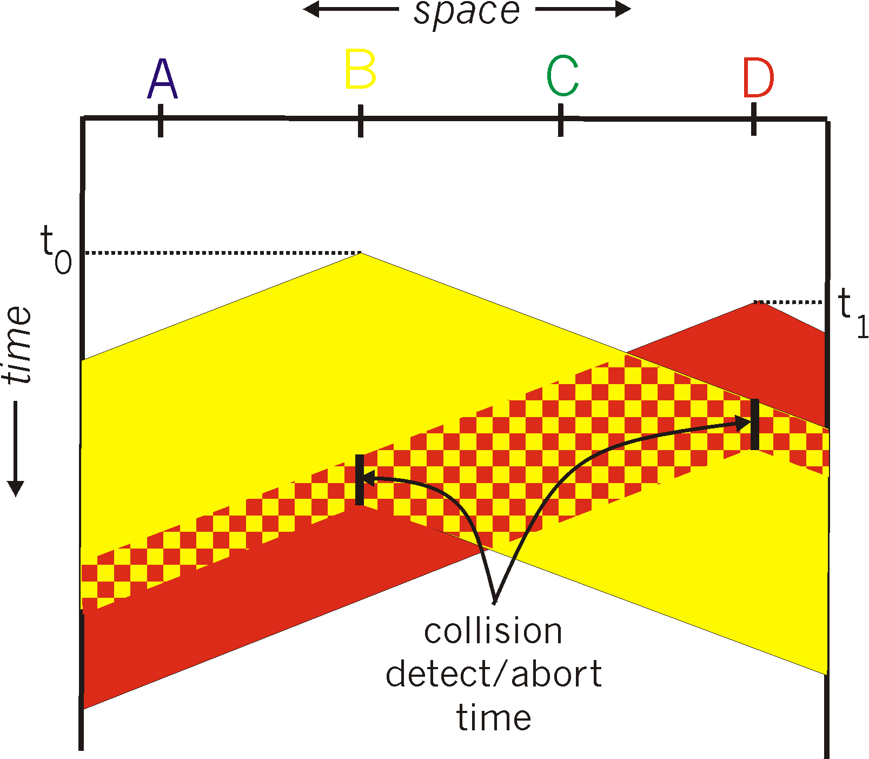
CSMA/CD (collision detection)
spatial layout of nodes

Slide 37
Ethernet CSMA/CD algorithm
4. If NIC detects another transmission while transmitting, aborts and sends jam signal
5. After aborting, NIC enters binary (exponential) backoff:
1. NIC receives datagram from network layer, creates frame
2. If NIC senses channel idle, starts frame transmission. If NIC senses channel busy, waits until channel idle, then transmits.
3. If NIC transmits entire frame without detecting another transmission, NIC is done with frame !

Slide 38
CSMA/CD efficiency
t_{prop} = max prop delay between 2 nodes in LAN
t_{trans} = time to transmit max-size frame
efficiency goes to 1
as t_{prop} goes to 0
as t_{trans} goes to infinity
Better performance than ALOHA: and simple, cheap, decentralized!

Slide 39
Objectives : Part 5
Our Objectives:
understand principles behind Toking Turns Protocols
Polling
Token Passing

Slide 40
MAC protocols
MAC Protocols
Channel Partitioning
Random Access
Taking Turns
Efficient and fair at High load
Inefficient at low load
Efficient at Low Load
Inefficient at high load
Best of both worlds?

Slide 41
“Taking turns” MAC protocols
Polling:
master node “invites” slave nodes to transmit in turn
typically used with “dumb” slave devices
Concerns:
polling overhead
latency
single point of failure (master)
data
poll
master
data
slaves

Slide 42
“Taking turns” MAC protocols
Token passing:
token message
control token passed from one node to next sequentially.
Concerns:
token overhead
latency
single point of failure (token)
T
(nothing
to send)
T
data

Slide 43
Summary of MAC protocols
channel partitioning, by time, frequency or code
Time Division, Frequency Division
random access (dynamic),
ALOHA, S-ALOHA, CSMA, CSMA/CD
carrier sensing: easy in some technologies (wire), hard in others (wireless)
CSMA/CD used in Ethernet
CSMA/CA used in 802.11
taking turns
polling from central site, token passing
Bluetooth, FDDI, token ring

Slide 44
THE END!

